Slide 1
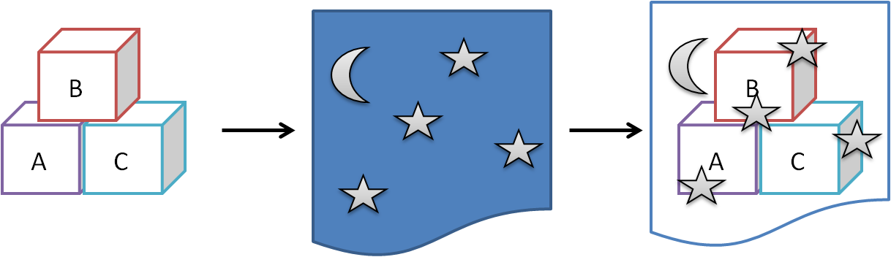

Research Methods in Developmental Psychology
[Professor Name]
[Class and Section Number]
Notes:
Classroom Recommendations: This material could be covered in one 50 to 75-minute class period. It is intended to present topics related to research design and methods in developmental psychology. Many instructors teach these topics as a review of basic methods taught in introductory or methodology courses. This module is intended to build on foundational knowledge (such as understanding the experimental method) and focus especially on conducting research with children and in the context of development. Please refer to the Lecture Framework in the Noba Instructor Manual for this module for specific details.
Overview: You may choose to begin by having students write a 3-5 sentence summary of the module content. This should, of course, only be done if the reading was assigned prior to the class session. You may also choose to have students generate questions from the reading related to material they found confusing or interesting. For a more involved warm up activity, see the slide titled “Warmup: Studying Development”.
Technical Note: These slides may contain simple click animation so that you can focus students’ attention on a particular question, a selection of text, or an image and not have them be distracted by reading ahead. You can either preview the sequence of animation by going through the slides in slideshow view, visiting the animations tab, or reviewing the slide notes. In the notes you will see a cue - (Click) – that corresponds to each animation.
You may also find hyperlinks to outside videos at various places in the slides. These hyperlinks are embedded in text and indicated by color and in the notes section.

Slide 2
Learning Objectives
Describe different research methods used to study infant and child development.
2. Discuss different research designs, as well as their strengths and limitations.
3. Report on the unique challenges associated with conducting developmental research.
Notes:
This slide outlines the learning objectives of the module.

Slide 3

Warmup: Studying Development
Notes:
The purpose of this slide is to facilitate an activity to get students thinking about researching developmental psychology. This is an opportunity to build on their general knowledge of research methods and to explore the everyday work context of developmental researchers. This introductory exercise encourages students to reflect on how they are currently different from when they were a child. You may opt to have them share their answers in pairs or small groups before debriefing with the class as a whole, although this will add time to the activity.
Materials: pen and paper for notes
PROMPT: Take a moment and recall yourself at age nine or ten. If it helps, try to remember a specific day such as a family trip, a birthday, or an interaction with a sibling or best friend. Remember yourself in as much detail as possible. You may choose to take some specific notes. How did you speak? What foods did you like? How did you dress? What did you think you were going to be when you grew up? What were your hobbies? Now, take a moment and determine in what ways you were different at that time than you are now. List the ways in which you are different.
Possible debriefing questions for the whole class:
-- have students share examples of how they have changed over the years. Then, ask the class to weigh in on how individual versus how universal human development is. Where do there appear to be broad similarities?
-- ask the students to offer personal theories of how and why various types of development happen
-- ask the students to project forward into the future. How different do they anticipate being on these same identified dimensions 10 or 20 years down the road? Then, ask them how they might go about researching their hypotheses regarding future development.
Note: You may choose to tie the student answers, and the broad themes of the discussion, to the topic of research methods. For example, having students notice real world differences in development in their own lives can lead to the generation of testable hypotheses. You may also choose to point out that developmental psychology, by definition, is interested in a person at multiple points in time, and this requires special attention to methods and design.

Slide 4
Overview
Warmup: Studying Development
Research Methods
Involuntary response
Voluntary response
Psychophysiology
Questionnaire/interview
Research Designs
Issues in Developmental Research
Wrap-up
Notes:
The purpose of this slide is to provide students with an overview of the material that will be covered during each portion of the lecture

Slide 5

Research Methods: Involuntary Response
Involuntary responses
Violation of expectation paradigm
Notes:
In this slide, the instructor can introduce research methods. Note that research methods is a “bottleneck term” and some students become stuck trying to disentangle the concept of methods from that of designs. You may choose to begin with a brief explanation of these two topics.
Research methods are the specific tools used by researchers to collect information. Two common types of methods used in research with adults are observation of behavior in laboratory experiments and information collected via interviews/surveys. Given that the lion’s share of research in developmental psychology is conducted with children it makes sense to consider how best to collect information from children who are either pre-verbal or have very limited vocabularies.
(Click) Involuntary responses - In this slide you can introduce the idea of involuntary responses (behaviors that require little or no conscious effort) as a means of collecting information from very young children and infants. Examples include eye tracking (the image on the slide shows an eye tracking experiment set up) or turning the head to track movement or sound.
(Click) Violation of expectation paradigm - Show the embedded 3 and a half minute video to introduce students to the “violation of expectation paradigm.” Explore student reactions to this method.
https://www.youtube.com/watch?v=l1VK2iawS34

Slide 6
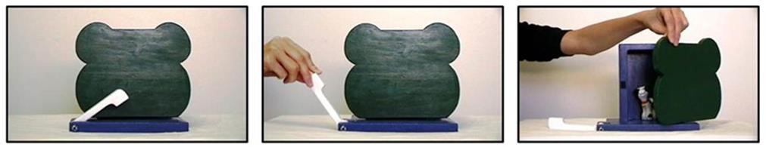
Research Methods: Voluntary Response
Event sequence
Find the Surprise
Video: Emotional information guides behavior
Notes:
In this slide, the instructor can introduce research with voluntary responses. As opposed to obligatory or involuntary response these responses are those that require more effortful thought and control. In developmental psychology, researchers often use imitation tasks to measure the extent to which small children can remember sequences.
(Click) Event sequence – a toy that children engage with and demonstrate voluntary responses in a study of memory
(Click) Find the Surprise – this is the toy/event sequence introduced in the module reading
(Click) Video: Emotional information guides behavior - In the embedded 2 and a half minute video, researchers are interested in the extent to which children modify their own behavior in relation to emotional tone. The experiment shows a child who is interested in various toys, but who elects not to play with them when it appears an adult will find the play irritating. Explore students reactions to this video and to voluntary response research more broadly.
https://www.youtube.com/watch?v=7FC4qRD1vn8

Slide 7
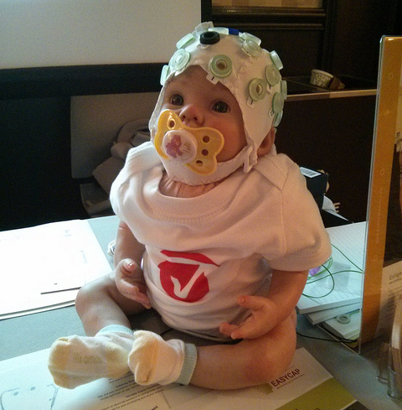
Research Methods: Psychophysiology
Levels of Analysis
Culture-Environment
Relationships-Groups
Behavior
Thoughts-Feelings-Perceptions
Physiology (hormones, blood, brain)
Chemistry/DNA
Event Related Potentials
Notes:
In this slide, the instructor can introduce psycho-physiological research methods. Because of the occasional tendency of some students to equate physiological methods with “real science” or “hard science” it may be helpful to remind them about levels of analysis. Levels of analysis assumes that psychological phenomena co-occur across different levels of analysis. At times, variables at one level cause variables at another but this is not always the case. It would be a mistake, for instance, for students to assume that “brain waves cause thinking.” Rather, it is more accurate to understand that the two concepts occur simultaneously and can be measured independently (brain activity, on the one hand, and conscious though on the other).
(Click) Culture-Environment, Relationships-Groups, Behavior, Thoughts-Feelings-Perceptions, Physiology, Chemistry/DNA
Please note that more information on levels of analysis can be found in the Introduction to Science of Social Psychology Module: http://nobaproject.com/modules/an-introduction-to-the-science-of-social-psychology#social-psychology-is-a-science
(Click) Event Related Potentials - In the embedded 2 and a half minute video, a researcher interested in mapping language acquisition in the brain uses event related potential (ERP) to measure brain activity in a child. She explains her research. Explore student reactions to this research, and to physiological methods in general.
https://www.youtube.com/watch?v=gMBYs-pP-9o

Slide 8

Research Methods: Questionnaires and Interviews
Notes:
In this slide the instructor can introduce surveys and interviews as a method of collecting research data. Note that these methods rely on verbal ability to some degree and are, therefore, more commonly used with school aged children. Examples of this method include:
-- the WPPSI-IV, a standardized test of intelligence for pre-schoolers
-- the Child Behavior Checklist (CBC), a list of various childhood behaviors such as nightmares, screaming, excessive fearfulness or chewing on objects
-- surveys sampling experience with drugs and alcohol; used to assess base rates of use by teens and pre-teens
Discussion: What advantages or disadvantages do you see with interviewing children? What about questionnaires with young people?
Possible answers might include:
-- limited vocabulary, difficulty articulating
-- lack of reliability (lying, wanting to please, etc)
-- lack of responding (afraid of researcher, research setting, etc)

Slide 9
Overview
Warmup: Studying Development
Research Methods
Research Designs
Longitudinal
Cross-sectional
Cross-sequential
Issues in Developmental Research
Wrap-up
Notes:
The purpose of this slide is to provide students with an overview of the material that will be covered during each portion of the lecture

Slide 10
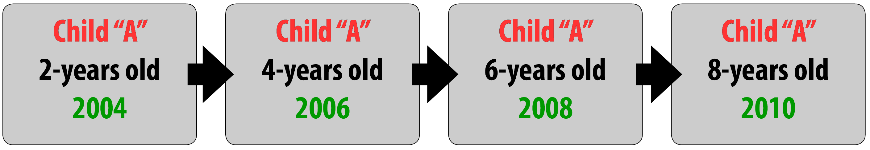
Research Designs: Longitudinal
Notes:
Here, instructors shift from research methods to research designs. Research designs are strategies (or “blueprints”) for deciding how to collect and analyze data. In this section of the lecture, instructors will cover three distinct research designs: longitudinal, cross-sectional, and cross-sequential.
Begin with longitudinal design (research examining the same participant or participants over multiple times). For example, if a researcher counted the number of words in a child’s vocabulary when she was 2 years old, in 2004, and then followed this same procedure every 2 years until the child was 8, in 2010. The diagram shows a single subject of a longitudinal study but make clear to students that a cohort could be studied in the same way.
Issues to consider:
-- the time periods do NOT need to be spaced at even internals nor do they need to occur over long periods of time (such as years). Any research that examines the same variables in the same participants at multiple times counts as longitudinal.
-- research can be “case study” (single subject) as in the example of studying one child’s response to therapy, or in aggregate across dozens or even thousands of children
-- care must be taken so that each administration of the measure is consistent
-- this research can be expensive and there is the potential problem of participants dropping out over time

Slide 11
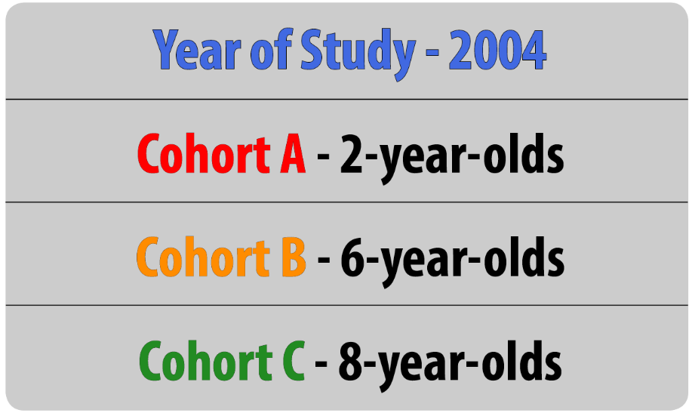
Research Designs: Cross-Sectional
Notes:
Here, instructors shift from longitudinal design to cross-sectional design. Cross-sectional designs are those that sample different cohorts at the same single point in time. For example, if – in 2004-- a researcher counted the number of words in the vocabularies of 2-year-olds, 6-year-olds, and 8-year-olds. Like the example used in the previous slide this would provide information about possible differences between age groups in language acquisition (overall vocabulary size in this instance).
Discussion: Have your students discuss– in pairs or small groups– the relative advantages or disadvantages of longitudinal and cross-sectional designs. Have them use the current example of the development of children’s vocabulary as the target of their discussion. When they are finished, you may want to debrief as a whole class. Main point may include:
-- cross-sectional designs are less likely to have attrition
-- cross-sectional designs are less costly
-- cross-sectional designs are less likely to be contaminated by context effects
-- longitudinal designs are less susceptible to cohort effects (more likely to show actual within-person change rather than differences between cohorts)

Slide 12
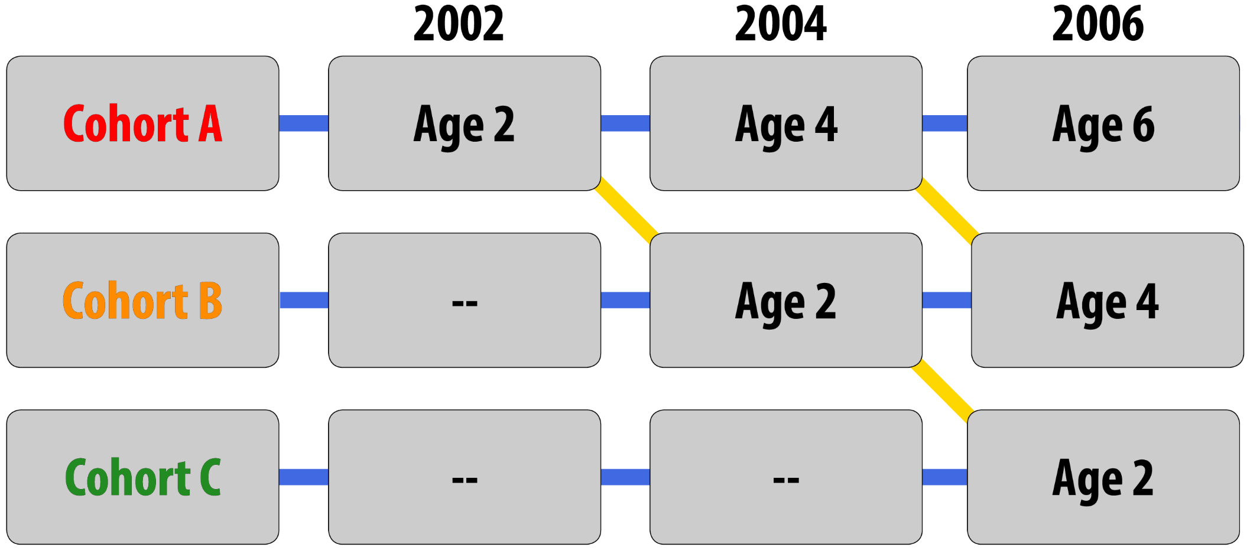
Research Designs: Sequential
Notes:
Here, instructors present the third and final research design covered in this module: cross-sequential design. Cross-sequential designs are a combination of longitudinal and cross-sectional in that they collect data from distinct cohort samples (cross-sectional) and follow each of these over a period of time (longitudinal).
This design allows for multiple analyses. First, it allows for a longitudinal analysis as illustrated by the blue horizontal bars in the figure above. For example, a researcher could look at the size of children's vocabulary when they are 2, 4 and 6 years old. The first data collection would begin– for example purposes– in 2002 when the first cohort was two years old. Then, at each subsequent data collection (every two years in this example) a new cohort of 2 year olds would begin the study. This allows for between groups (between cohorts) analyses shown by the yellow lines in the figure above. This design has the advantages of both longitudinal and cross-sectional designs.
Discussion question: If cross-sectional designs are so strong (have so many advantages) why don’t researchers always use them?
Possible answers include:
-- they are expensive
-- they are complicated
-- they are not appropriate to every research question
--there is a risk of attrition

Slide 13
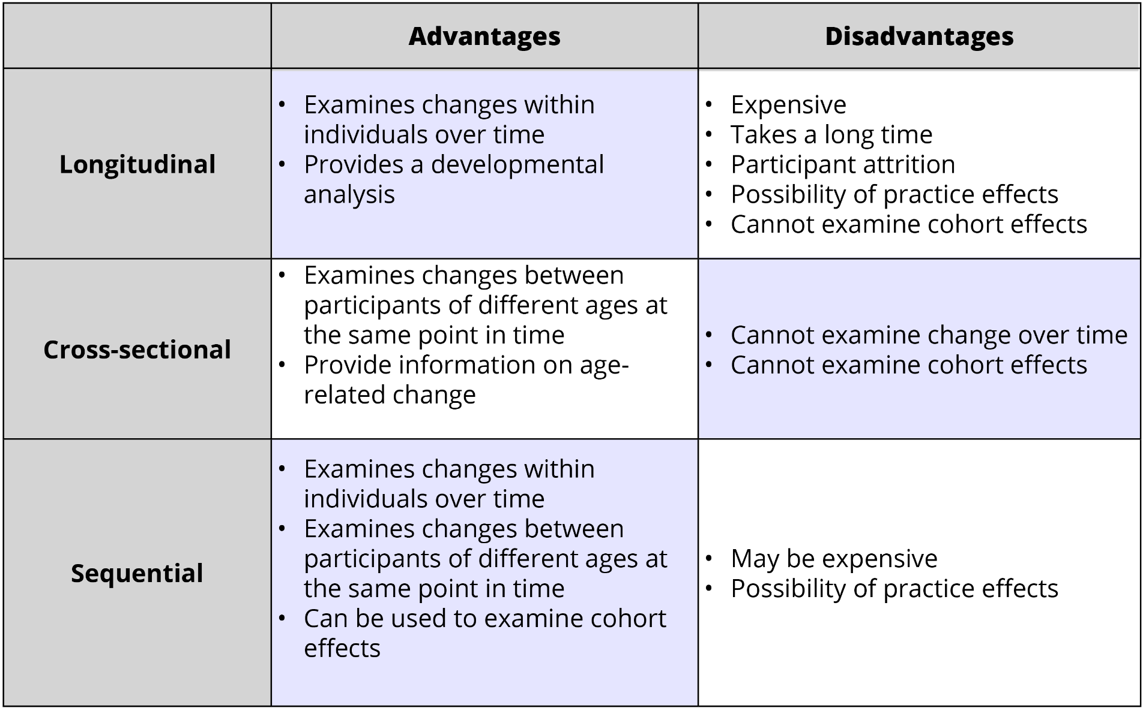
A Comparison of Designs
Notes:
This slide shows the relative advantages and disadvantages of each of the three designs discussed earlier. It can be helpful to students to have the various designs presented succinctly in this way. You can use this slide as a review slide of this section, perhaps even offering a short quiz about the three designs.
You can also use it to have students apply their knowledge. For example, break the class into small groups and have them consider which design they would choose if they wanted to study:
The development of the ability to manage fear in children
The development of hand-eye coordination in children
How children’s answer to the question “what do you want to be when you grow up?” changes across their youth

Slide 14
Overview
Warmup: Studying Development
Research Methods
Research Designs
Issues in Developmental Research
Informed consent
Recruitment
Attrition
Wrap-up
Notes:
The purpose of this slide is to provide students with an overview of the material that will be covered during each portion of the lecture

Slide 15
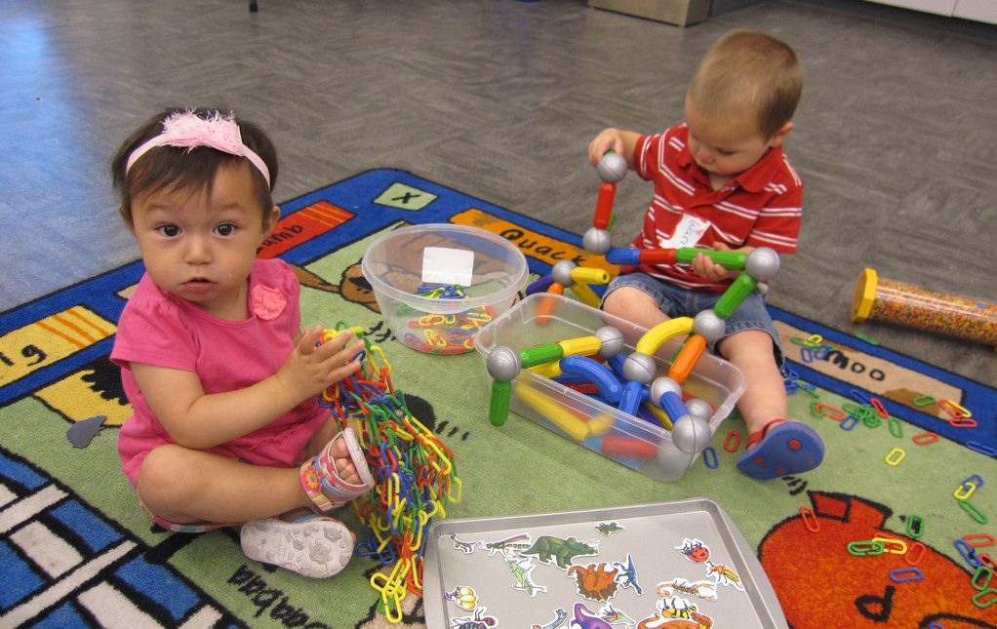
Issues
Informed Consent
Attrition
Recruitment
Notes:
In this slide, instructors can present problems and considerations specific to conducting research with children. You may opt to review the idea of professional ethics and explain the IRB ethics approval process. Ultimately, ethical research justifies intrusions into privacy or the experience of some unpleasantness by arguing that the potential benefits of the research outweigh any potential risks.
There are several issues related to research conducted with children. Here, you can present three of them: informed consent, attrition, and recruitment.
(Click) Informed consent: in general, people must give informed consent before participating in research. This means that they have been informed about the length and purpose of the study, any risks associated with the study, any compensation associated with the study, and that they have the right to withdraw from the study at any time. Because small children and infants cannot fully understand these issues or make mature decisions regarding participation parents give informed consent on behalf of their children. Discussion question: How appropriate do you think it is for parents to give informed consent for teenagers to participate in research? What influences your answer?
(Click) Attrition: One problem in research is incomplete data. This occurs when participants drop out of a study prematurely. Attrition, as this phenomenon is called, is particularly problematic with children. Discussion question: Why might attrition be higher among children than among adult participants? (Possible answers: children cannot independently arrive at the research site. Children are more prone to stressful reactions during research. Children may become ill at a higher rate than adults.)
(Click) Recruitment: It is widely acknowledged that the lion’s share of research participants in psychology studies are university students. This is because it is convenient for researcher– who largely work at universities– to recruit them. It is more difficult to recruit children. Announcements of research must be posted in places where children and parents are. Similarly, research has to be conducted at a time that is convenient for both parents and their children. Discussion question: If you wanted to research the phenomenon of “imaginary friends” how would you recruit participants?

Slide 16

CAT: One-Minute Paper
What was the most important thing you learned during this class?
What will you do with this information? How will it affect your life?
What important question remains unanswered?
Notes:
This slide helps you have students complete a one-minute paper. The Minute Paper tests whether students are gaining knowledge, or not.
(Click) What was the most important thing you learned during this class?
(Click) What will you do with this information? How will it affect your life?
(Click) What important question remains unanswered?
Have students briefly answer these questions in writing and turn them in. After class, assess students’ responses. At the beginning of the next class, go over any misunderstandings or relevant questions.
If you do not conclude with this Classroom Assessment Technique (CAT), it would helpful to use another CAT. For more information on CATs click here: http://cft.vanderbilt.edu/guides-sub-pages/cats/

Slide 17
Photo Attribution
Slide 1 | Photo Credit: Ydolem2689 https://en.wikipedia.org/wiki/File:Example_of_Object_Permanence_.png https://creativecommons.org/licenses/by-sa/3.0/deed.en
Slide 3 | Photo Credit: stumayhew https://www.flickr.com/photos/65331292@N00/5567115451/ https://creativecommons.org/licenses/by-nc-nd/2.0/
Slide 5 | Photo Credit: adrianvfloyd https://www.flickr.com/photos/128281807@N03/27548099900/ https://creativecommons.org/licenses/by-nd/2.0/
Slide 6 | Photo Credit: Angela Lukowski used with permission
Slide 7 | Photo Credit: Matt Cain https://www.flickr.com/photos/mattcain/10907276725 https://creativecommons.org/licenses/by-nc-nd/2.0/
Slide 8 | Photo Credit: Public Domain
Slide 15 | Photo Credit: Pioneer Library System https://www.flickr.com/photos/7339259@N08/14282447942/ https://creativecommons.org/licenses/by-nc-nd/2.0/
Notes:
This is a photo attribution slide.

